Slide 1
Design And Analysis of Algorithms
Department of Information Technology
-----Group Members-----
VIKRAM SINGH ( IIT2019213 )
AKSHAT AGRAWAL ( IIT2019214 )
RAVUTLA RUTHVIK ( IIT2019215 )
ASSIGNMENT-4 DEMONSTRATION
Under the Supervision of: Dr. Rahul Kala
Under the Mentorship of: Tejasvee bisen

Slide 2
INDEX
Introduction and Problem Statement
Divide and Conquer
Approach Used
Algorithm
Conclusion
References

Slide 3
Problem Statement
Given an n x n matrix, where every row and column is sorted in
increasing order. Given a key, how to decide whether this key is in the
matrix. Solve using divide and conquer algorithm.

Slide 4
Divide and Conquer
Divide and Conquer is an algorithm design paradigm in which we recursively break down a problem into two or more sub-problems of the same or related type, until these subproblems become simple enough to be solved directly.
This technique has a wide variety of uses. Binary Search and Merge Sort are some such example.

Slide 5
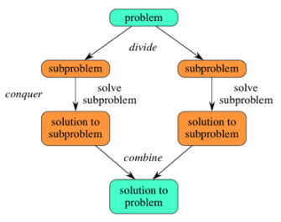
The approach of divide and conquer generally follows 3 important aspects:
1. Divide the problem into a number of subproblems that are smaller instances of the same problem.
2. Conquer the subproblems by solving them recursively. If they are small enough, solve the subproblems as base cases.
3. Combine the solutions to the subproblems into the solution for the original problem.

Slide 6
Approach
The idea is to find the middle element of the 2-D matrix and depending on whether that element is smaller or greater than the key element , search the key element in the following sub-matrices

Slide 7
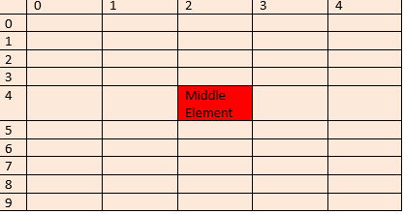
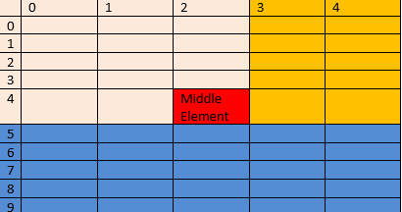
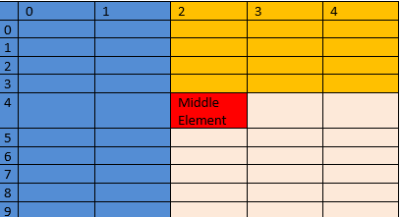
If middle element equals key
2. If middle element is lesser than key then:
a) search submatrix on lower side of middle element (Blue)
b) Search submatrix on right hand side.of middle element (Yellow)
3. If middle element is greater than key then:
a) search vertical submatrix on left side of middle element (Blue)
b) search the submatrix on the right hand side (Yellow)

Slide 8
Algorithm
1) Find the middle element.
2) If the middle element is the same as key return.
3) If middle element is lesser than key then:
a) search submatrix on lower side of middle element
b) Search submatrix on right hand side.of middle element
4) If middle element is greater than key then:
a) search vertical submatrix on left side of middle element
b) search the submatrix on the right hand side

Slide 9
PSEUDO CODE
Below is the pseudo code for the search function which contains the algorithm described above.
As this function is a recursive function it has the following base conditions which needs to be checked every time the function is called:
● If the given row column pair does not contain any value i.e. number of elements is 0, then return false.
● If the given row column pair contains a single value i.e. number of elements is 1, then return true if the element is equal to key else return false.
● If the biggest element in the row column pair is less than the key element or the smallest element in the row column pair is greater than the key element, then return false. After checking the base conditions, we check if the middle element is equal to key. If not, we further check the submatrices as described above.

Slide 10
mid_row = (row_end + row_start) / 2;
mid_column = (column_end + column_start) / 2;
if (key == mat[mid_row][mid_column])
return true
else if (key > mat[mid_row][mid_column])
return search (mat, row_start, mid_row, mid_column + 1, column_end, key) ||
search (mat, mid_row + 1, row_end, column_start, column_end, key);
else return search(mat, row_start, mid_row - 1, mid_column, column_end, key) ||
search (mat, row_start, row_end, column_start, mid_column - 1, key);
}
search (mat,row_start,row_end,column_start,co lumn_end,key)
{
if (row_start > row_end || column_start > column_end)
return false
if (row_end == row_start && column_end == column_start)
if (mat[row_end][column_end] == key)
return true
else return false
if (mat[row_start][column_start] > key || mat[row_end][column_end] < key)
return false
// Base conditions

Slide 11
ALGORITHM ANALYSIS
Since we input a 2-D matrix of size NXN, it will require O(n² ) space.
Also as the number of variables used in every function call are fixed, if we try to calculate the total number of function calls made (using the method used for calculating time complexity), we get O(n 1.58 ) space complexity.
Thus the overall space complexity of the algorithm is = O(n ^{1.58} ) + O(n² ) ≈ O(n² ).
Space Complexity: O(n²)
For the above approach based on divide and conquer, the algorithm can be seen as recurring for 3 matrices of size n/2 x n/2.
Time Complexity:
Following is recurrence for time complexity T(n) = 3T(n/2) + O(1)
The time complexity for such an recurrence relation can we found out using the Masters Algorithm which comes out to be O(n^{1.58})
Time complexity: O(n^{1.58})

Slide 12
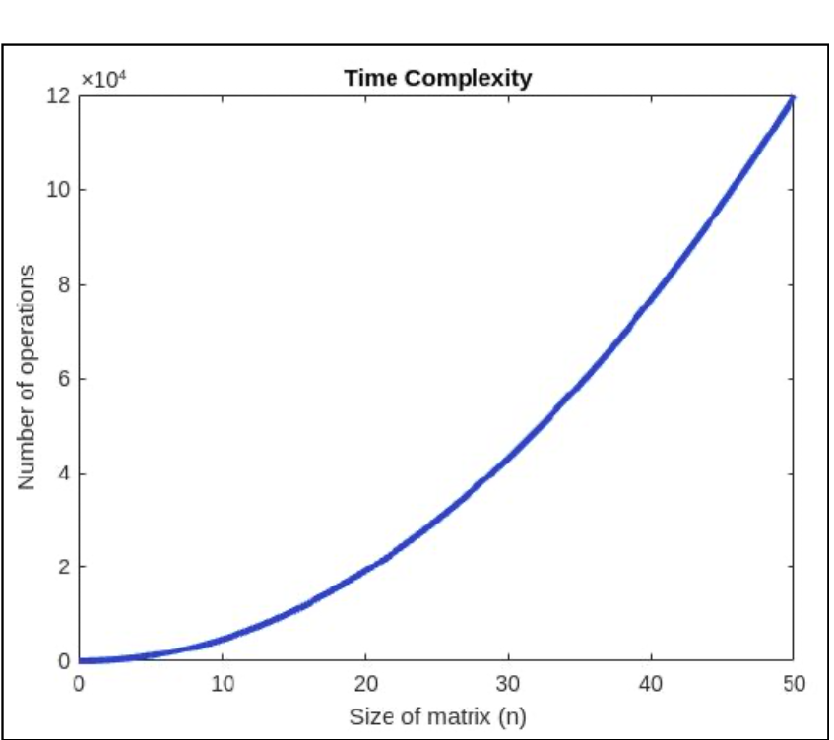
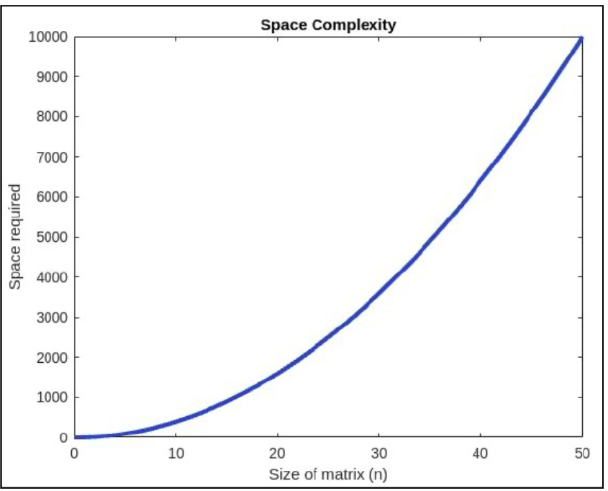
Profiling
Apriori analysis
The theoretical time complexity that we arrived after the calculations were:
Time Complexity : O(n^{1.58}) Space Complexity : O(n²)

Slide 13
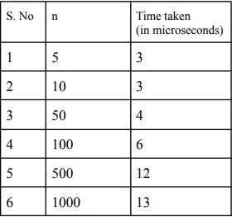
Posteriori analysis
For the Posteriori analysis of the algorithm, we have run our code on the compiler and get values of the time by specifying the value of n and as a result we got different values of the time.
Unfortunately, in the compilers on our system, declaration of a 2-D array of size more than n=10³ was not possible.
To plot a meaningful graph, large values of n are required.
Hence, plotting of the graph was not possible.

Slide 14
CONCLUSION
We have used a divide and conquer approach with the motive to reduce the time and space complexity of the algorithm.
But we find that although this algorithm is better than the standard brute force algorithm which has a time complexity of O(n²​ ​), upon further analysis we find that this problem could also have been solved in O(n) time complexity.
We shall not elaborate that method in this presentation, as this research paper focuses on solving the problem through divide and conquer method.
Hence, we conclude that in this case although the divide and conquer method is better than the brute force approach, it is not the best method for this particular problem.

Slide 15
REFERENCES
[1] Introduction to Algorithms / Thomas H. Cormen . . . [et al.]. - 3rd edition.
[2] The Design and Analysis of Algorithms (Pearson) by A V Aho, J E Hopcroft, and J D Ullman
[3] Algorithm Design (Pearson) by J Kleinberg, and E Tard
[4]https://www.geeksforgeeks.org/search-in-a-row-wise-and-column-wise-sorted-2d-array-u sing-divide-and-conquer-algorithm/

